Slide 1
Language Model Transformer
Deep Learning Project
Submitted by Anand Prakash Saini

Slide 2
Objective
Implement a transformer-based, character-level language model (GPT-like) and train it on the Shakespeare dataset. In the end generate Shakespearean-like text given a seed string.

Slide 3
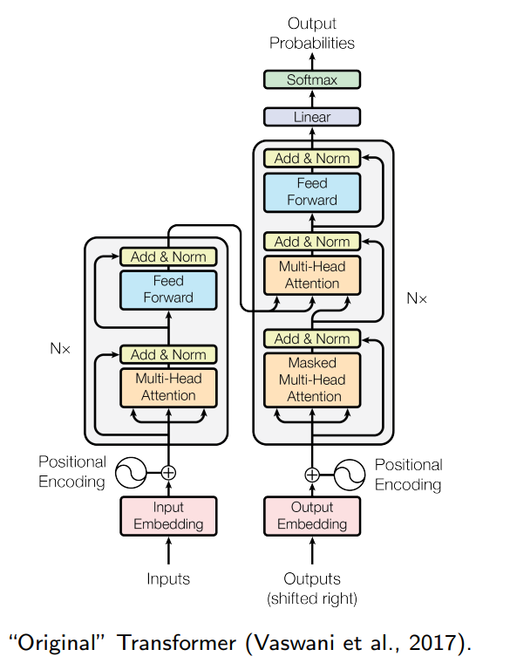
What is Transformer?
Neural network architecture that on attention mechanisms.
Unlike RNNs and LSTMs, transformers process entire sequences of data simultaneously.
This parallel processing significantly speeds up training.
Transformers, as introduced in the influential paper "Attention Is All You Need"

Slide 4
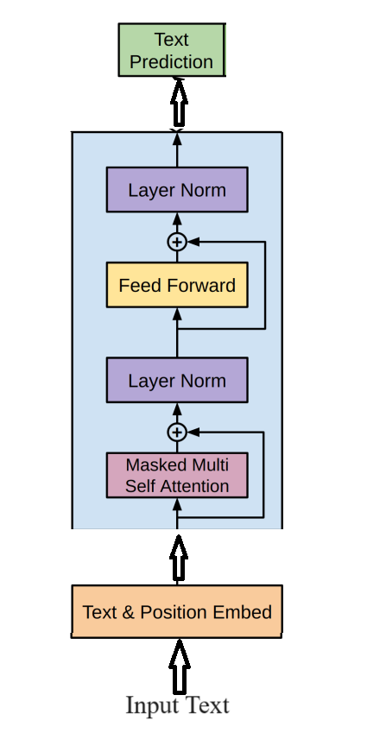
Decoder Only Transformer for Text Generation:

Slide 5
1. Input Data Tokenization
2. Embedding
3. Positional Embedding

Slide 6
4. Decoder Block

Slide 7
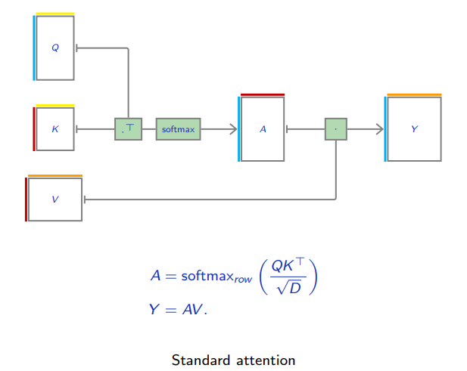
4.1. Attention Mechanism

Slide 8
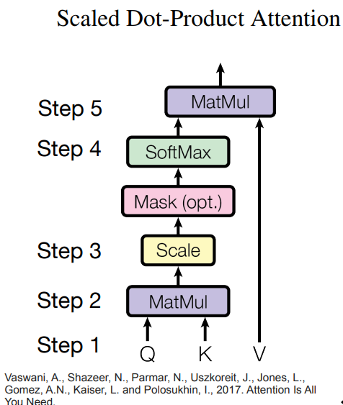
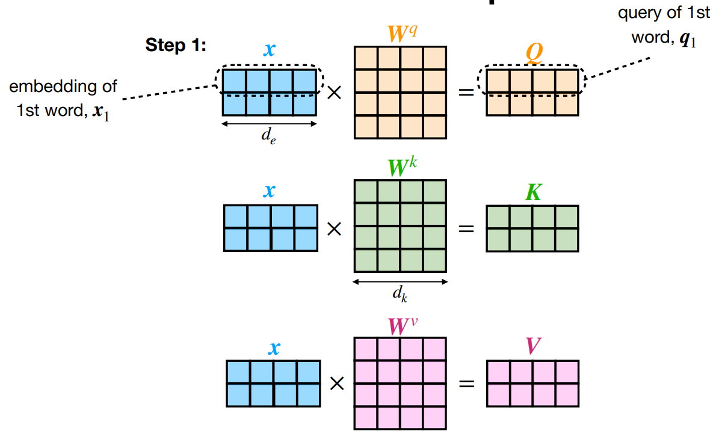

Slide 9
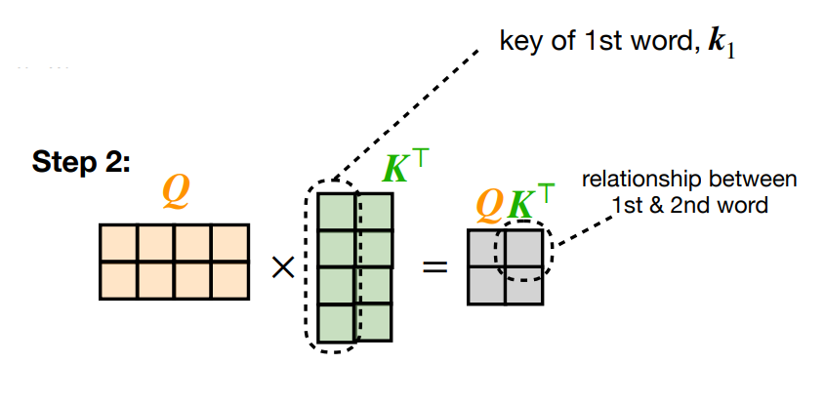
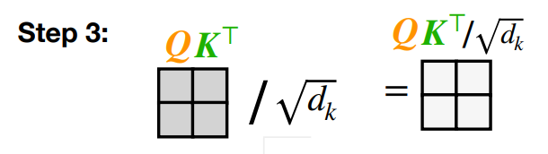

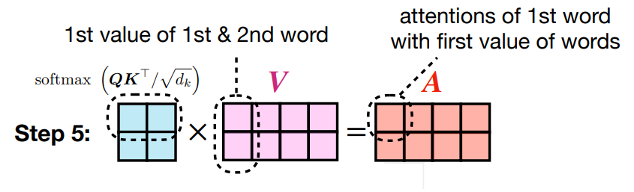

Slide 10
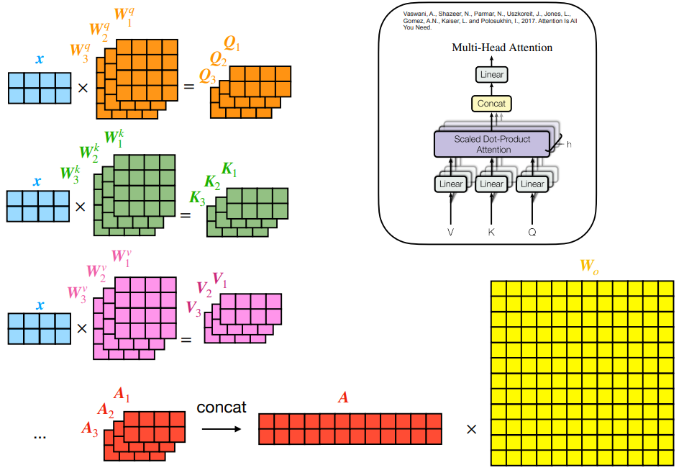
4.2 Multi Head Attention

Slide 11
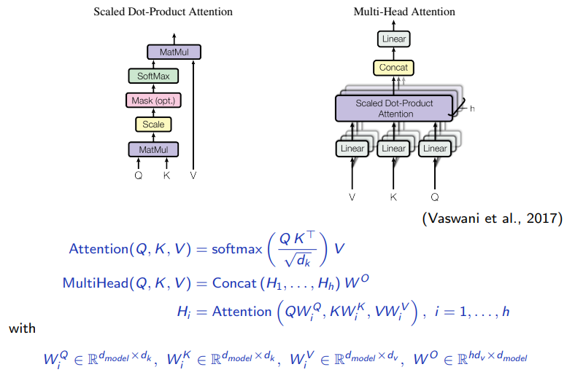
4.2 Multi Head Attention

Slide 12
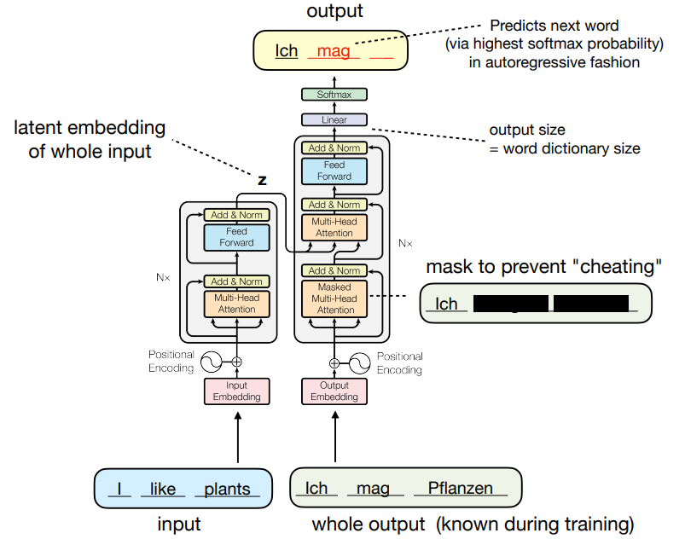
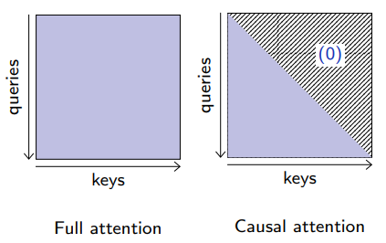
4.3 Masked Multi Head Attention

Slide 13
4.4 Residual/Skip Connection
Allows the output of one layer to bypass intermediate layers and be added to the output of a later layer.
Masked multi-head attention output and the feed-forward network is added to their respective inputs before being passed to the next layer or process.
Benefits:
Mitigating Vanishing Gradients: Gradients become increasingly small, impeding the learning process. Residual connections help alleviate this by allowing gradients to flow more directly through the network.
Enhancing Learning: By adding the input directly to the output, the network can preserve the original information, which makes learning easier and more efficient.
F(x) + x, where F(x) is the output from the network layers, and x is the original input.

Slide 14
4.5 Layer Normalization:
Technique used to normalize the inputs across the features for each data sample individually.
It computes the mean and variance used for normalization from all of the summed inputs to the neurons in a layer on a single training case.
Stable Training: It helps in stabilizing the training process, as it ensures that the distribution of the inputs to a layer doesn't change much across different mini-batches, which is a problem known as internal covariate shift.
Faster Convergence: By normalizing the input layer, the model often converges faster, as it prevents the network from getting into regions where the activation functions (like sigmoid or tanh) saturate and gradients vanish.
Reduced Sensitivity to Hyperparameter Settings: Models with layer normalization tend to be less sensitive to the initialization of parameters and learning rate settings.

Slide 15
4.6 Feed-Forward Neural Network:
Two Linear Transformations with a Non-Linearity:
The first linear layer expands the dimensionality of the input
Second one compresses it back to the original dimensionality.
Activation Function:
This non-linearity allows the network to capture more complex patterns in the data, which linear operations alone cannot.
Processing Each Position Independently: Unlike the self-attention mechanism that processes the entire sequence in a collective manner, the FFNN operates on each position independently. It means that for each token's embedding, the FFNN performs the same operation but does not consider other positions in the sequence during this step.
Complex Representation Learning: The FFNN further transforms the output of the self-attention layer, allowing the model to learn more complex representations. This is important for tasks like language modeling, where understanding nuanced patterns and relationships in the data is key.
Contribution to Model’s Capacity: The FFNN significantly contributes to the model's capacity (i.e., its ability to model complex phenomena) without increasing the dependencies between different positions in the sequence. This is vital for maintaining the parallelizability of the Transformer architecture.

Slide 16
4.7 Linear Layer:
Fully connected neural network layer that maps the output of the decoder blocks to a different space.
The linear layer takes these vectors and transforms them into a new space, typically with dimensionality equal to the size of the model's vocabulary.
This transformation is essential for preparing the decoder output for the final step in the model's output generation process.

Slide 17
4.8 Softmax Layer:
4.9 Output Probabilities:

Slide 18
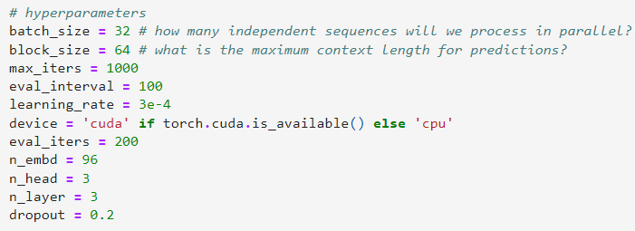
Hyperparameters:

Slide 19
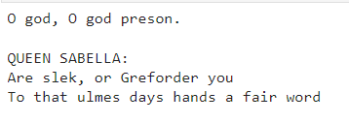
Results:

Slide 20
References:
Prof. François Fleuret's Lectures on deep learning: https://fleuret.org/dlc/
Sebastian Raschka Lecture: https://sebastianraschka.com/blog/2021/dl-course.html
Lecture video on GPT by Andrej Karpathy: https://www.youtube.com/watch?v=kCc8FmEb1nY&t=3786s
Lecture video on transformers by Aladdin Persson:https://www.youtube.com/watch?v=U0s0f995w14
Lecture video by Sebastian Raschka: https://www.youtube.com/playlist?list=PLTKMiZHVd_2KJtIXOW0zFhFfBaJJilH51
Github Repo Andrej Karpathy: https://github.com/karpathy/ng-video-lecture
https://pytorch.org/tutorials/intermediate/seq2seq_translation_tutorial.html

